Slide 1

STRATEGY EVALUATION
Lecture Hours:50
Department of Management Studies
Visvesvaraya Technological University Belagavi-590018
Module#6
SUBJECT : MBA 205- CORPORATE STRATEGY
Faculty of Management Studies
VTU, Belagavi

Slide 2

COURSE OUTLINE
Lecture | Lecture Name | Lecture Hours
#1 | Module-1 Overview of strategic management | 7
#2 | Module-2 ASSESSING EXTERNAL ENVIRONMENT | 9
#3 | Module-3 ASSESSING INTERNAL ENVIRONMENT | 9
#4 | Module-4 STRATEGY FORMULATION | 9
#5 | Module-5 STRATEGY IMPLEMENTATION | 9
#6 | Module-6 STRATEGY EVALUATION | 7
 | Total Hours | 50

Slide 3
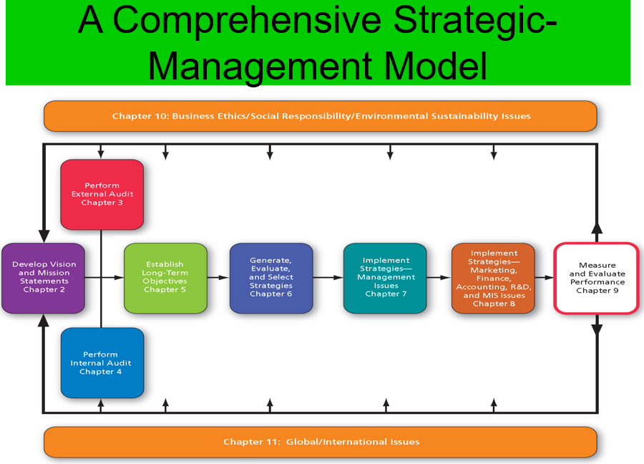

Slide 4
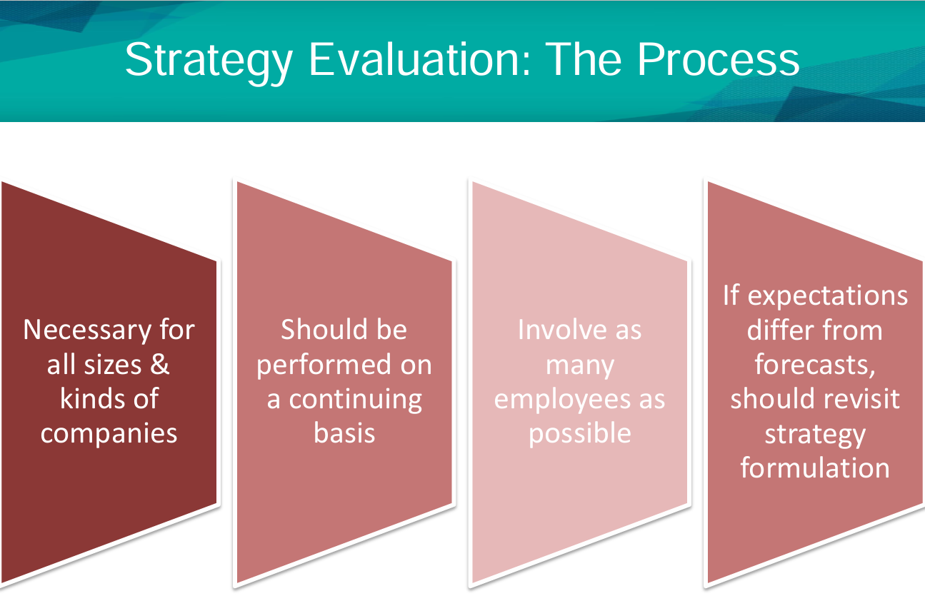

Slide 5
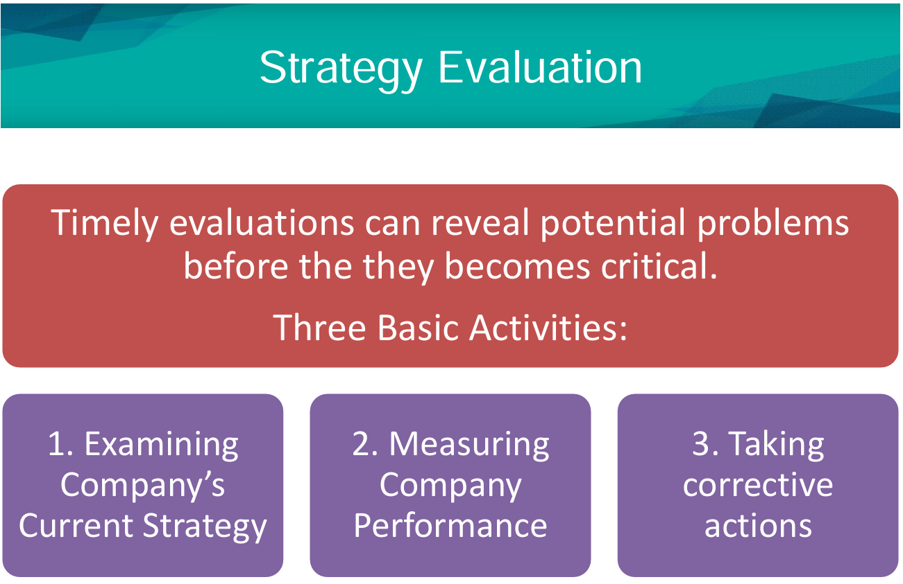
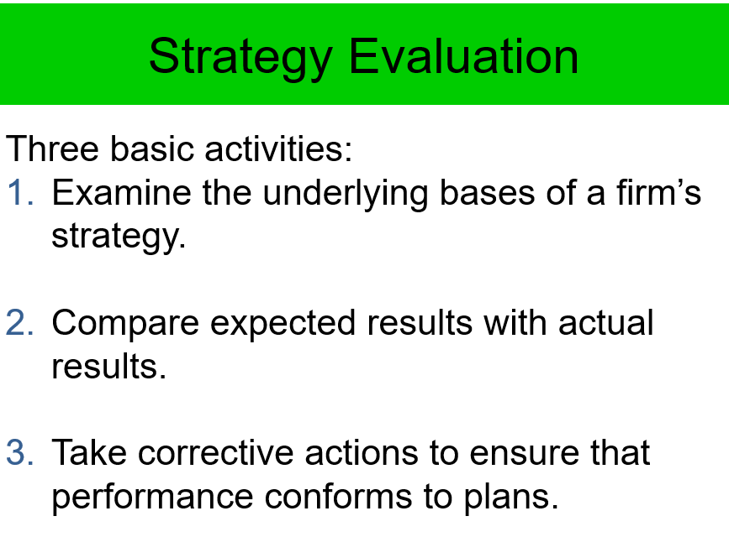

Slide 6
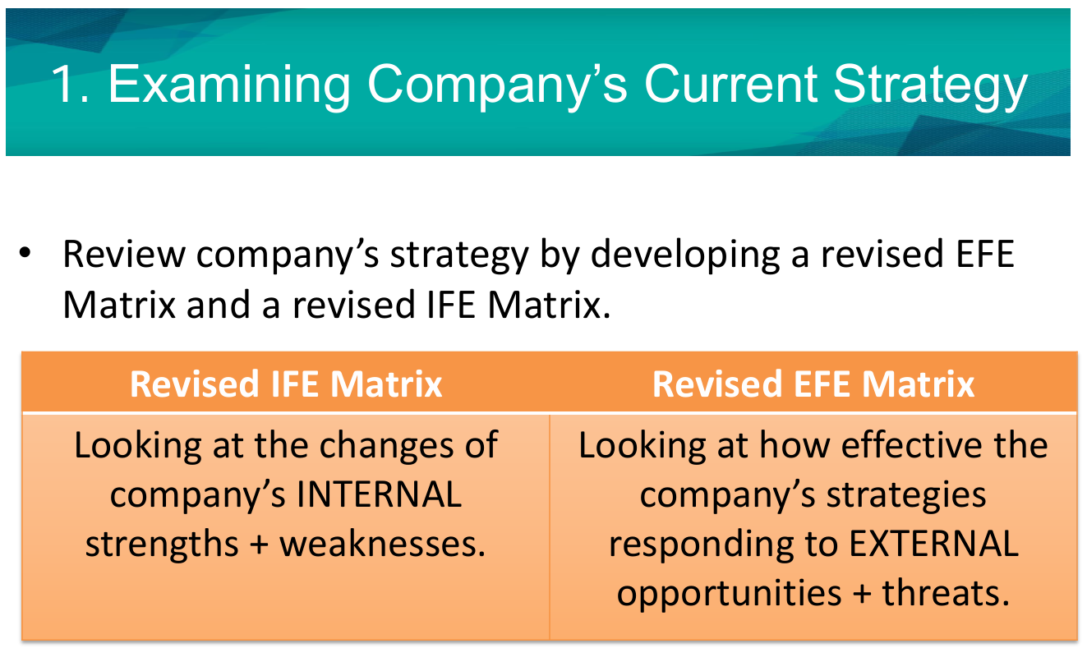

Slide 7
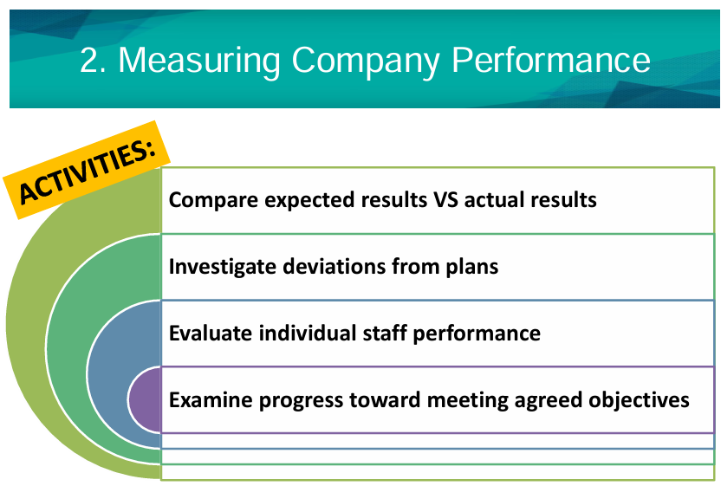
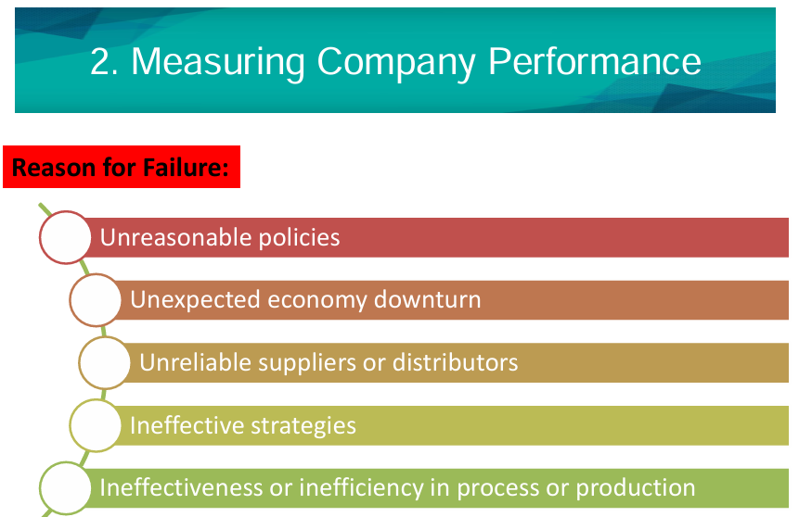

Slide 8
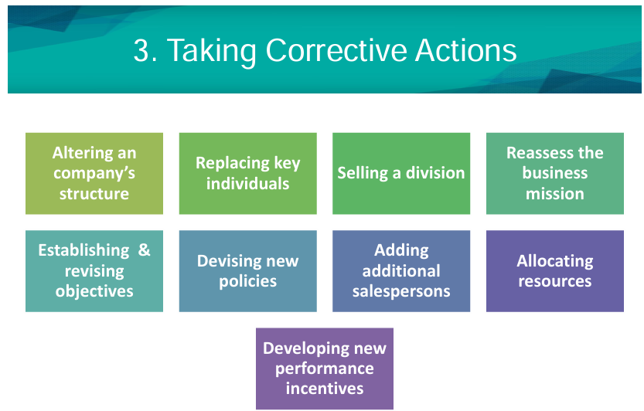
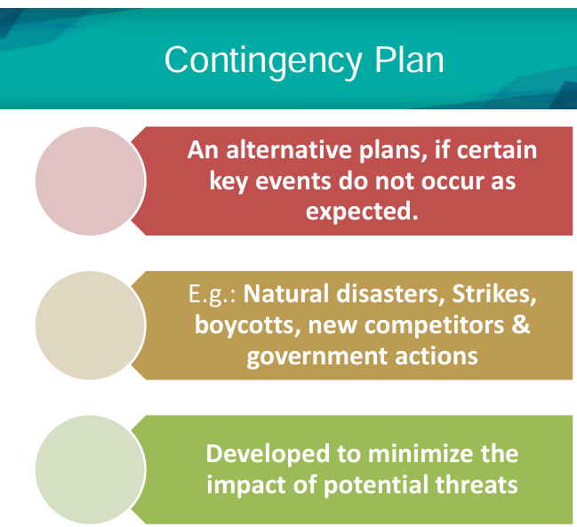

Slide 9
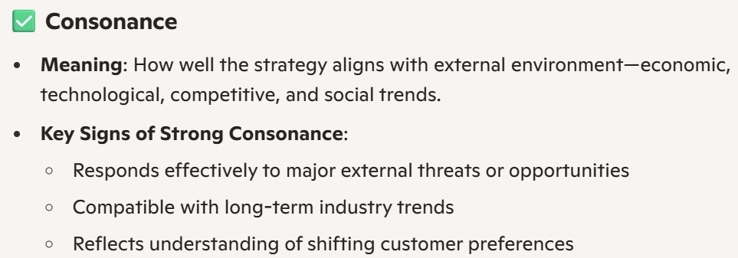
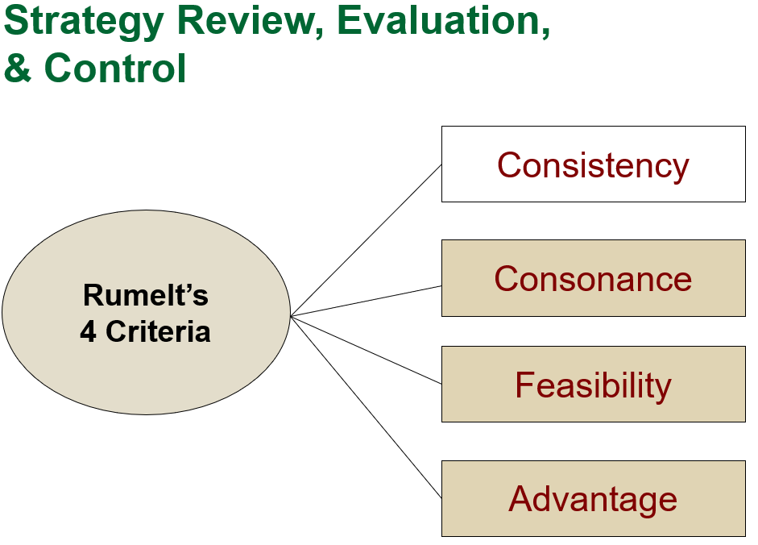
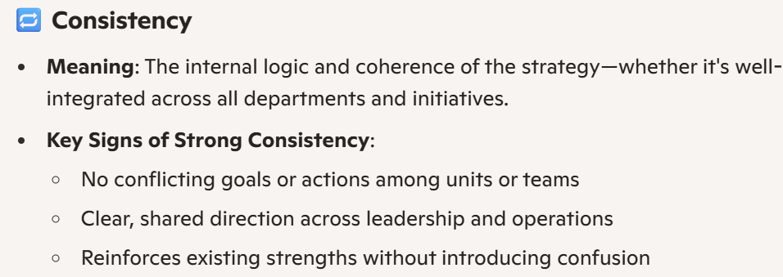
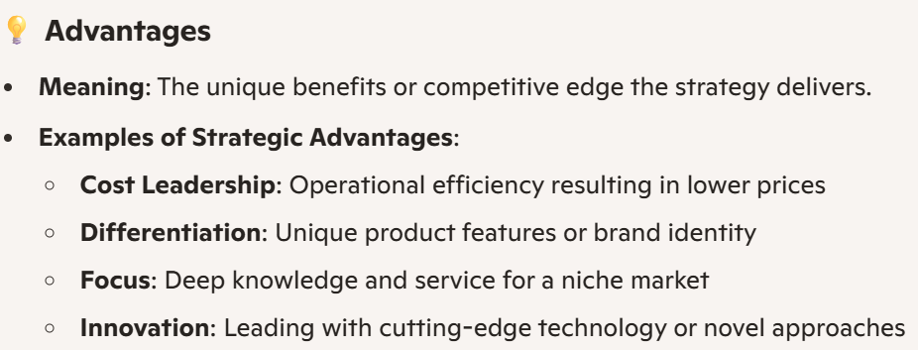
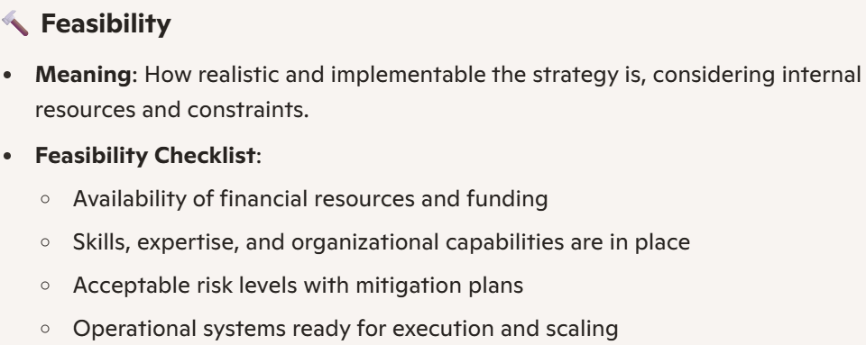

Slide 10
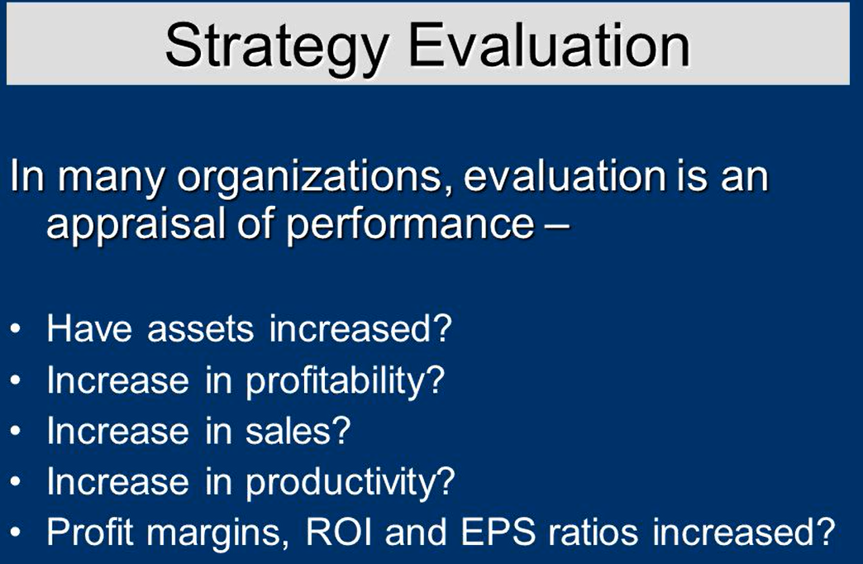

Slide 11
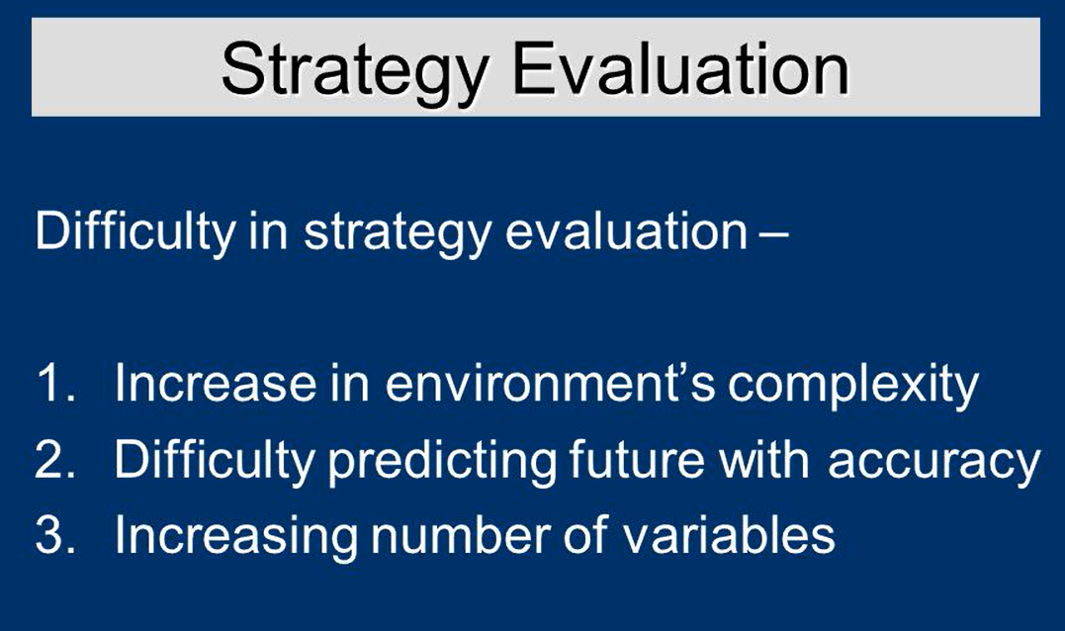
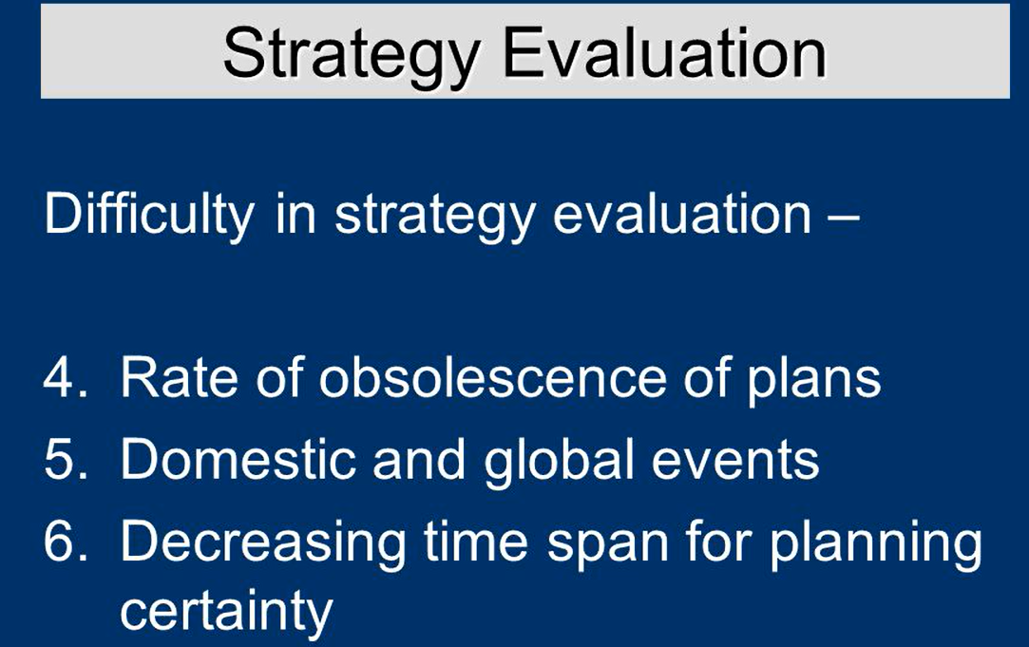

Slide 12
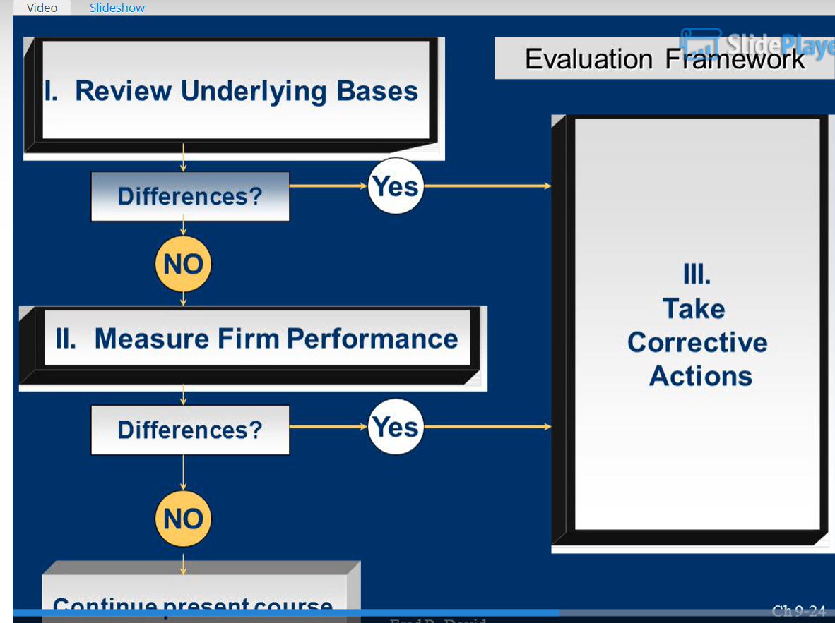

Slide 13
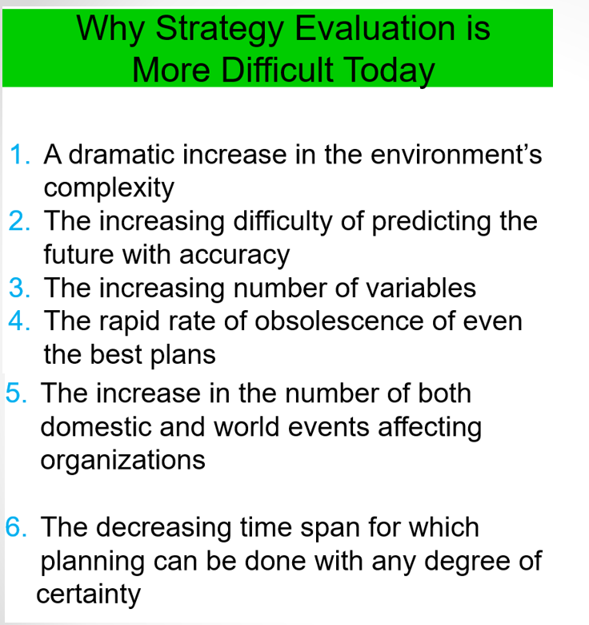

Slide 14
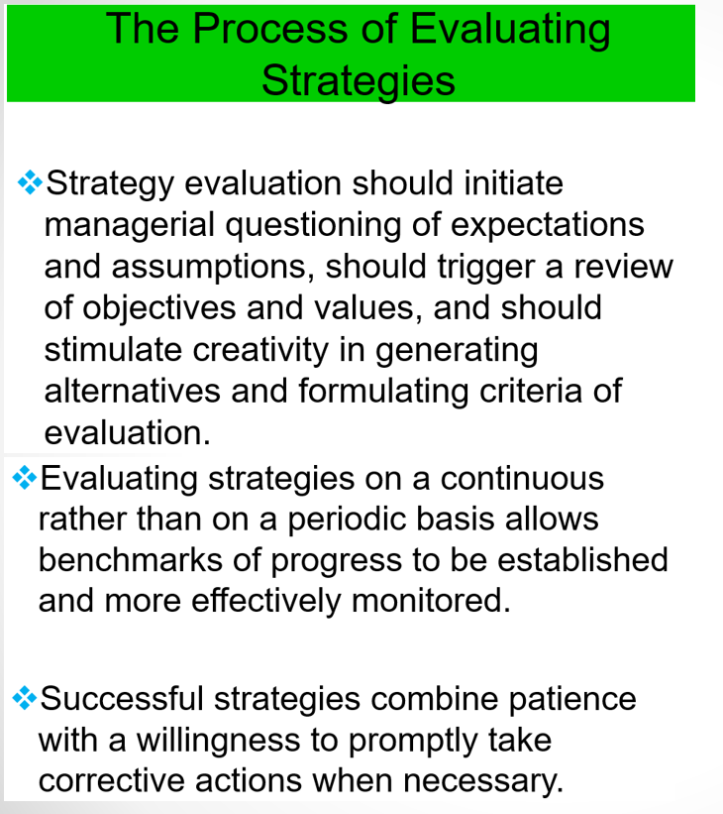

Slide 15
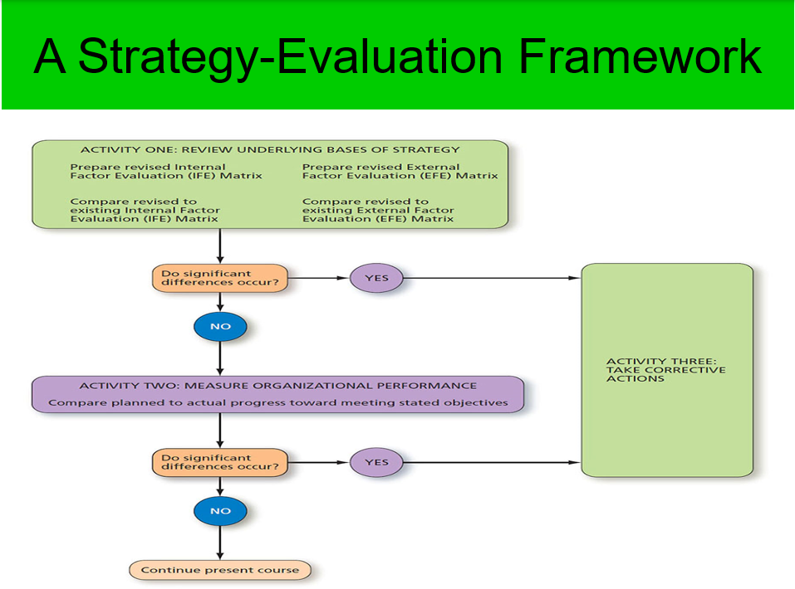

Slide 16
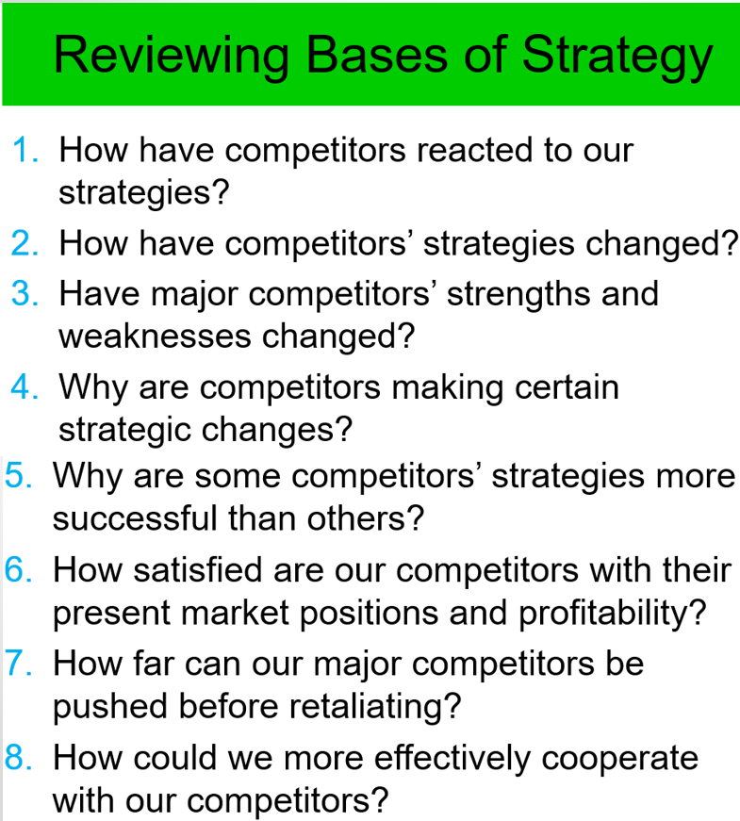

Slide 17
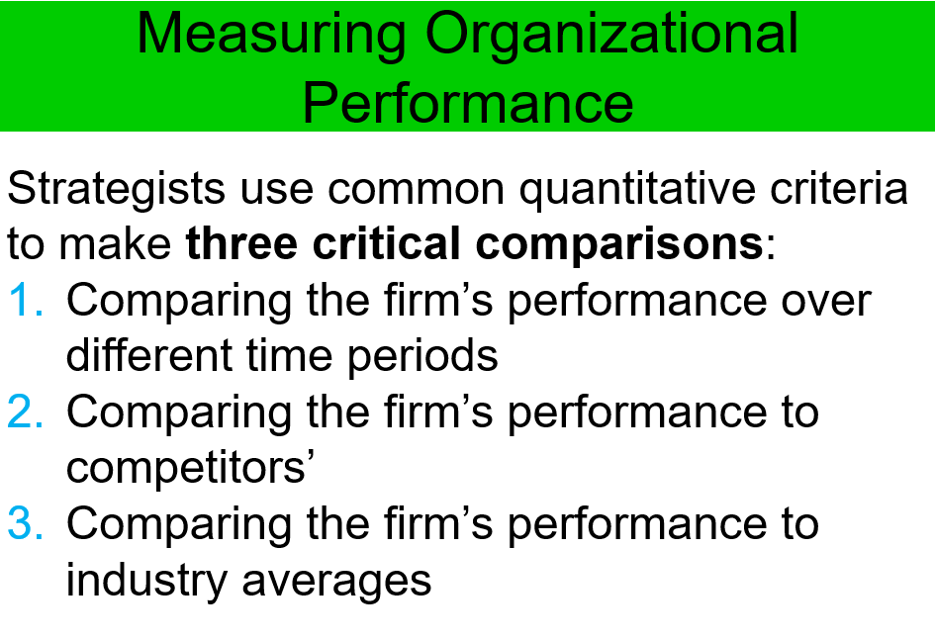

Slide 18
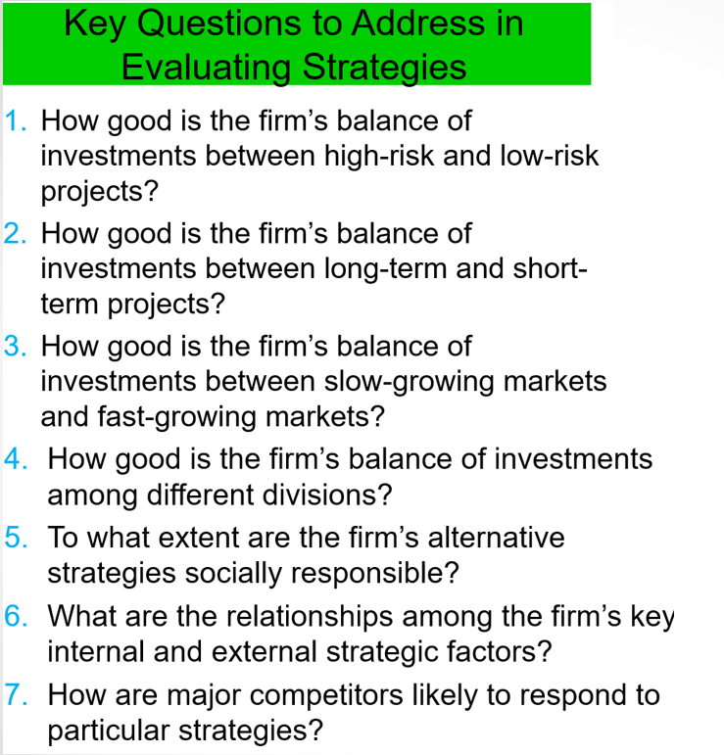

Slide 19
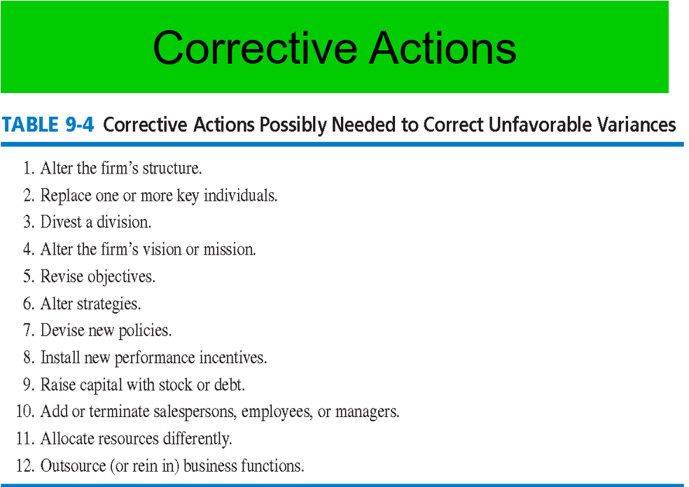

Slide 20
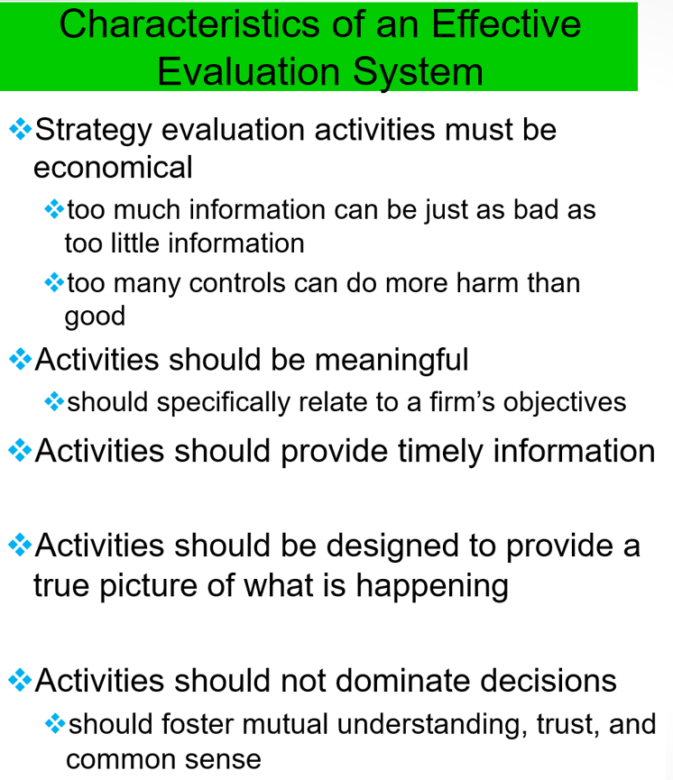

Slide 21
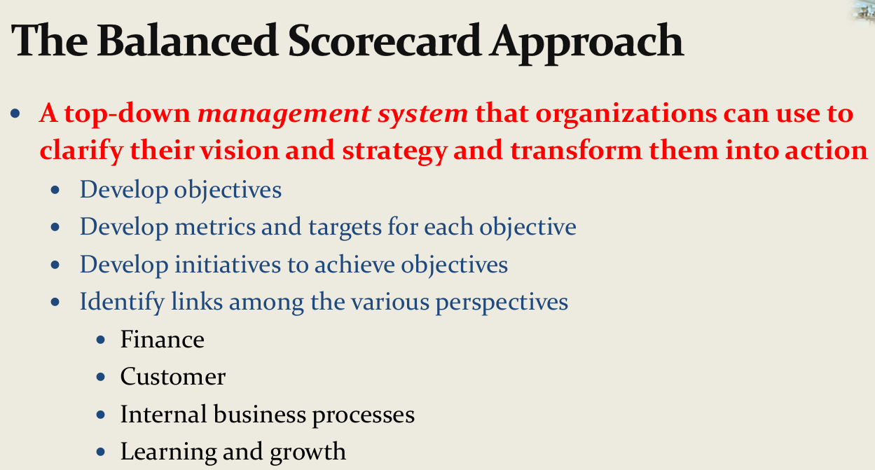
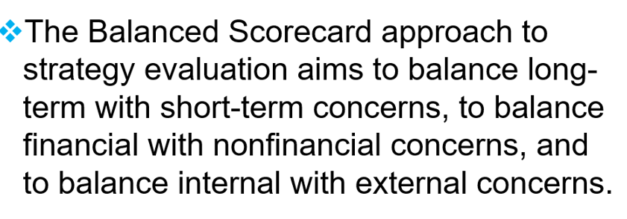

Slide 22
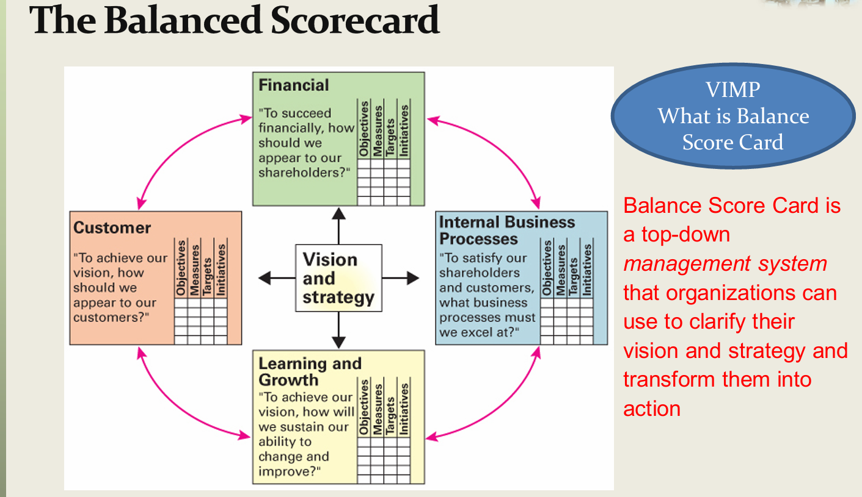

Slide 23
The balanced scorecard is a new management concept which helps managers at all levels monitor results in their key areas. An article by Robert Kaplan and David Norton entitled "The Balanced Scorecard - Measures that Drive Performance"
"The Balanced Scorecard: Translating Strategy into Action“
The scope of the measures to include four areas:
financial performance,
customer knowledge,
internal business processes,
learning and growth.

Slide 24
This allows the monitoring of present performance, but also tries to capture information about how well the organization is positioned to perform well in the future.
Kaplan and Norton cite the following benefits of using the balanced scorecard:
Focusing the whole organization on the few key things needed to create breakthrough performance.
Helping to integrate various corporate programs, such as quality, re-engineering, and customer service initiatives.
Breaking down strategic measures to local levels so that unit managers, operators, and employees can see what's required at their level to roll into excellent performance overall.

Slide 25
THANK YOU

